Slide 1
Mathematical Foundations
MFDS Team

Slide 2
* ZC416, Lecture 0

Slide 3
Agenda
Matrices and their types
REF and RREF
Rank, its computation and properties
Determinant, its computation and properties
Consistency and inconsistency of linear systems
Nature of solutions of linear systems

Slide 4
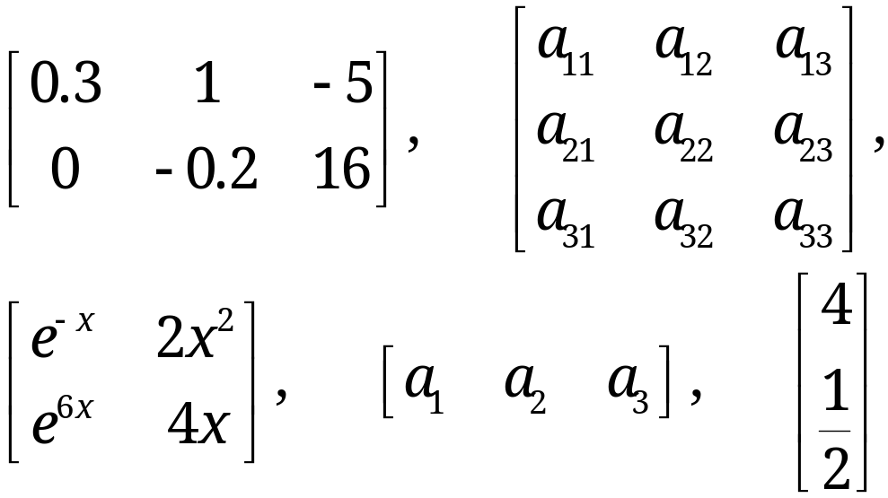
Matrices
A matrix is a rectangular array of numbers or functions which we will enclose in brackets. For example,
(1)
The numbers (or functions) are called entries or, less commonly, elements of the matrix.
The first matrix in (1) has two rows, which are the horizontal lines of entries.

Slide 5
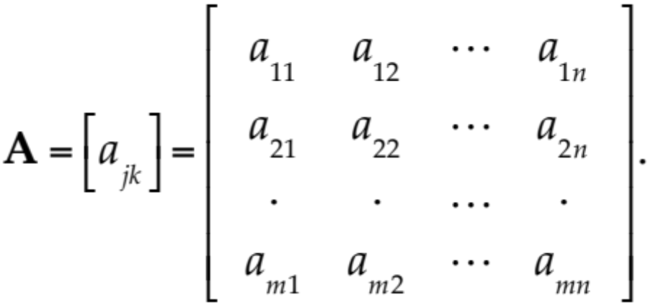
Matrix – Notations
We shall denote matrices by capital boldface letters A, B, C, … , or by writing the general entry in brackets; thus A = [a_{jk}], and so on.
By an m × n matrix (read m by n matrix) we mean a matrix with m rows and n columns—rows always come first! m × n is called the size of the matrix. Thus an m × n matrix is of the form
(2)

Slide 6
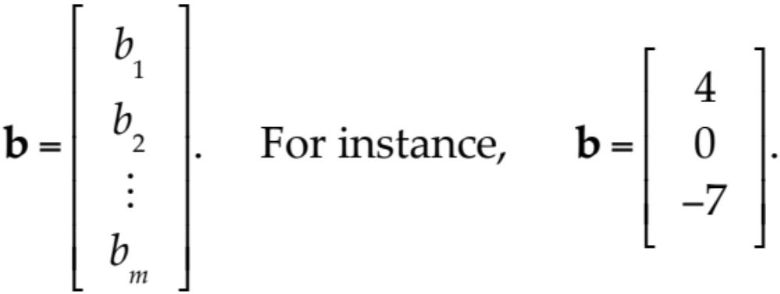
Vectors
A vector is a matrix with only one row or column. Its entries are called the components of the vector.
We shall denote vectors by lowercase boldface letters a, b, … or by its general component in brackets, a = [a_{j}], and so on. Our special vectors in (1) suggest that a (general) row vector is of the form
A column vector

Slide 7
Equality of Matrices
Two matrices A = [a_{jk}] and B = [b_{jk}] are equal, written A = B, if and only if (1) they have the same size and (2) the corresponding entries are equal, that is, a₁₁ = b₁₁, a₁₂ = b₁₂, and so on.
Matrices that are not equal are called different. Thus, matrices of different sizes are always different.

Slide 8
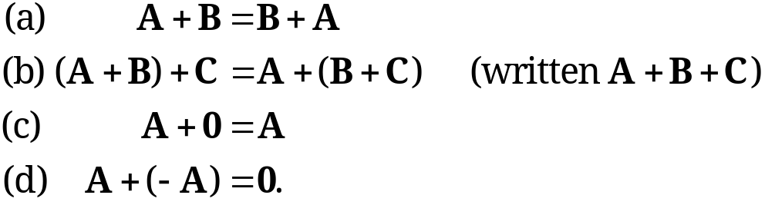
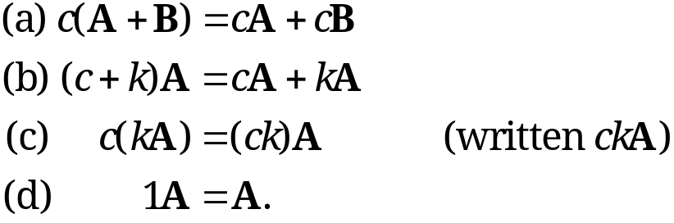
Algebra of Matrices
1. Addition of Matrices
The sum of two matrices A = [a_{jk}] and B = [b_{jk}] of the same size is written A + B and has the entries a_{jk} + b_{jk} obtained by adding the corresponding entries of A and B. Matrices of different sizes cannot be added.
2. Scalar Multiplication (Multiplication by a Number)
The product of any m × n matrix A = [a_{jk}] and any scalar c (number c) is written cA and is the m × n matrix cA = [ca_{jk}] obtained by multiplying each entry of A by c.
Here 0 denotes the zero matrix (of size m × n), that is, the m × n matrix with all entries zero.

Slide 9
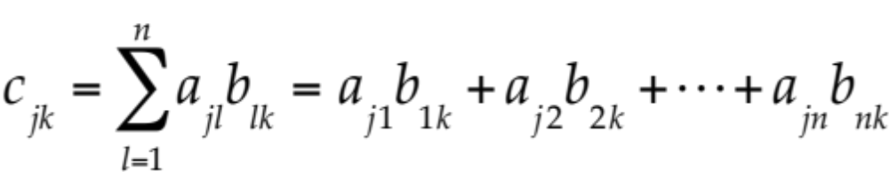
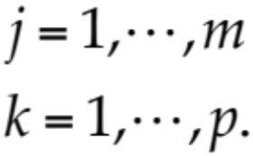
Matrix Multiplication
Multiplication of a Matrix by a Matrix
The product C = AB (in this order) of an m × n matrix A = [a_{jk}] times an r × p matrix B = [b_{jk}] is defined if and only if r = n and is then the m × p matrix C = [c_{jk}] with entries
(3)
The condition r = n means that the second factor, B, must have as many rows as the first factor has columns, namely n. A diagram of sizes that shows when matrix multiplication is possible is as follows:
A B = C
[m × n] [n × p] = [m × p].

Slide 10
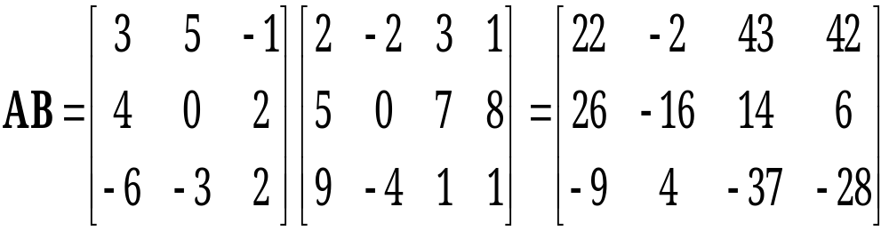
Matrix Multiplication
EXAMPLE 1
Here c₁₁ = 3 · 2 + 5 · 5 + (−1) · 9 = 22, and so on. The entry in the box is c₂₃ = 4 · 3 + 0 · 7 + 2 · 1 = 14.
The product BA is not defined.

Slide 11
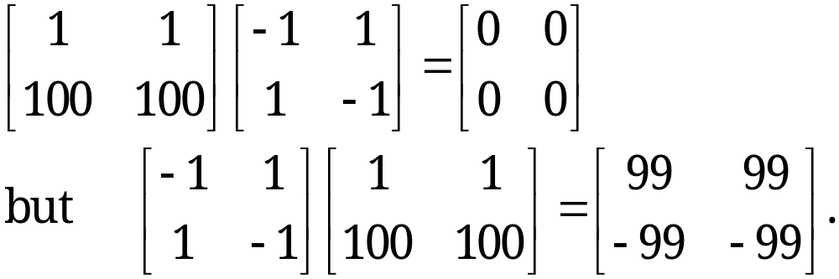
Matrix Multiplication
Matrix Multiplication Is Not Commutative, AB ≠ BA in General
This is illustrated by Example 1, where one of the two products is not even defined. But it also holds for square matrices. For instance,
It is interesting that this also shows that AB = 0 does not necessarily imply BA = 0 or A = 0 or B = 0.

Slide 12
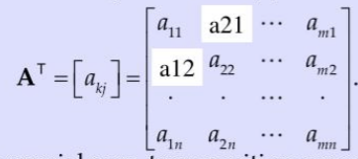
Transposition of Matrices & Vectors
The transpose of an m × n matrix A = [a_{jk}] is the n × m matrix A^{T} (read A transpose) that has the first row of A as its first column, the second row of A as its second column, and so on. Thus the transpose of A in (2) is A^{T} = [a_{kj}], written out
As a special case, transposition converts row vectors to column vectors and conversely.
Notes:
Dimensions of A^{T} are the reverse of dimension of A

Slide 13
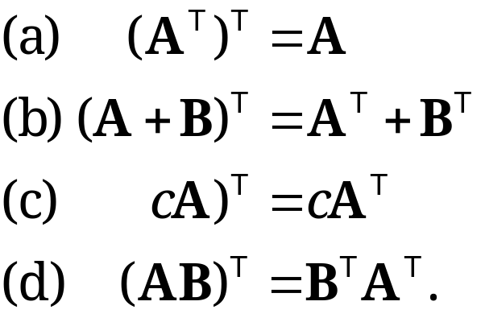
Transposition of Matrices
Rules for transposition are
(5)
CAUTION! Note that in (5d) the transposed matrices are in reversed order.
(

Slide 14
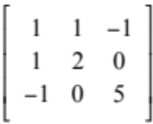
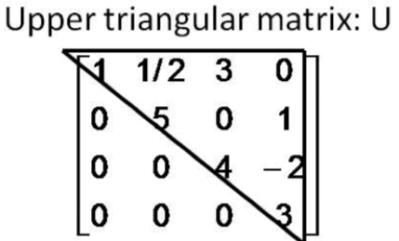
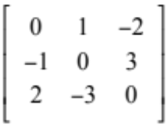
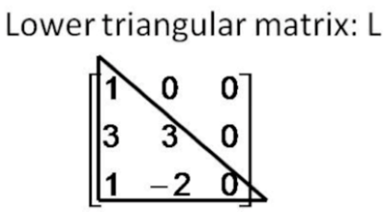
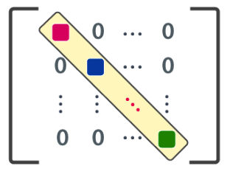
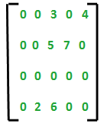
Special Matrices
Symmetric: a_{ij} = a_{ji} Eg:
Skew Symmetric : a_{ij} = - a_{ji} Eg:
Triangular: Upper Triangular → a_{ij} = 0 for all i > j
Lower Triangular → a_{ij} = 0 for all i < j
Diagonal Matrix: a_{ij} = 0 for all i ≠ j Eg:
Sparse Matrix: Many zeroes and few non-zero entities
Notes:
Symmetric : A^{T} = A
Skew Symmetric A^{T} = - A

Slide 15
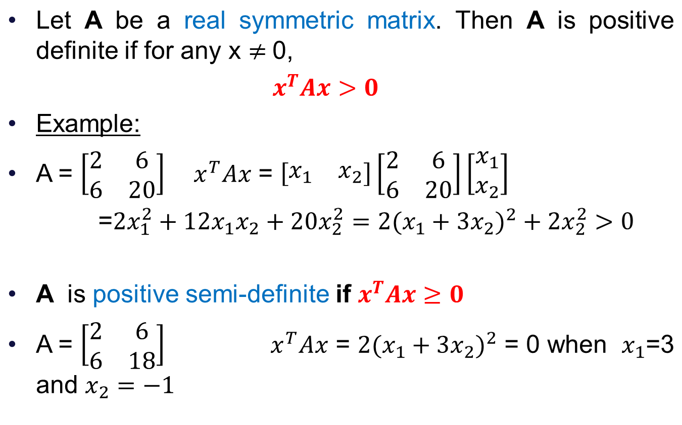
Positive Definite matrix

Slide 16
Elementary Row Operations
Given a matrix A, the following operations are called Elementary Row Operations
Interchange of two rows
Addition of a constant multiple of one row to another row
Multiplication of a row by a non-zero constant c
CAUTION! These operations are for rows, not for columns!

Slide 17
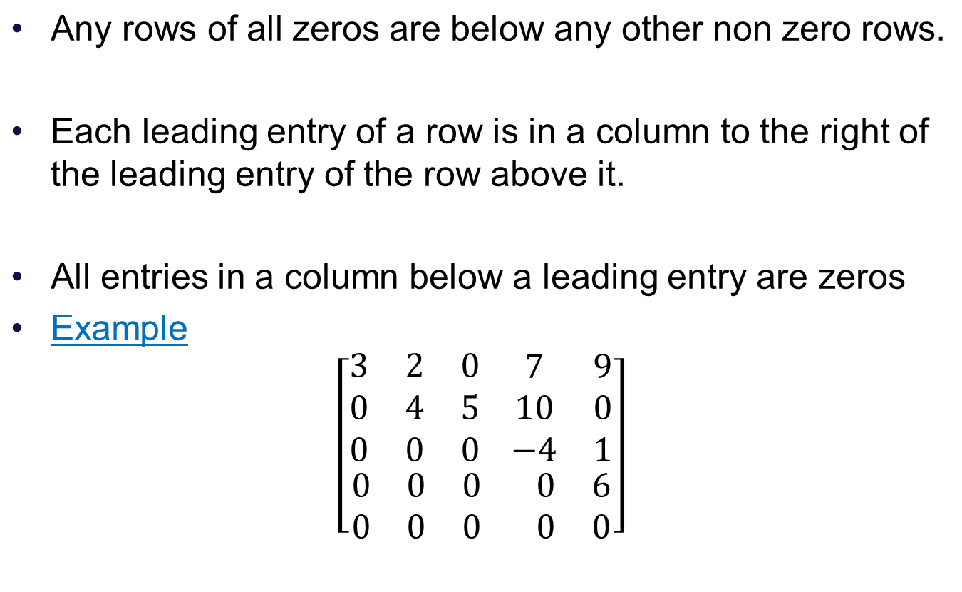
Row Echelon Form (REF) of a matrix

Slide 18

Reduced Rpw Echelon Form (RREF)
We say that a matrix is in Reduced Row Echelon Form if it is in Echelon form and additionally,
1. The leading entry in each row is 1.
2. Each leading 1 is the only non zero entry in its
column

Slide 19
Uniqueness of Row Reduced Echelon Form
We can transform any matrix into a matrix in reduced row echelon form by using elementary row operations.
No matter what sequence of row operations we use each matrix is row equivalent to one and only one reducedrow echelon matrix

Slide 20
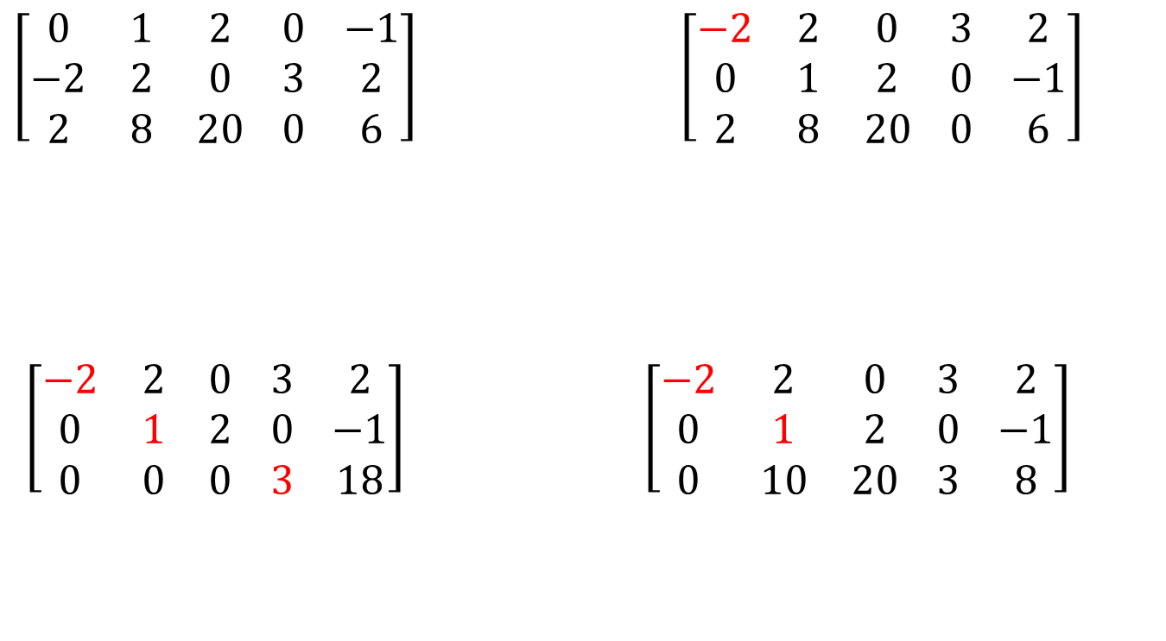
REF of a Matrix
Swap rows 1 and 2
Replace R3 by R3+1.R1
Replace R3 by R3+(-10).R2
Row Echelon Form

Slide 21
Rank of a matrix
The number of nonzero rows, r, in the reduced row (or row echelon form) coefficient matrix R is called the rank of R and also the rank of A.
The rank is invariant under elementary row operations:

Slide 22
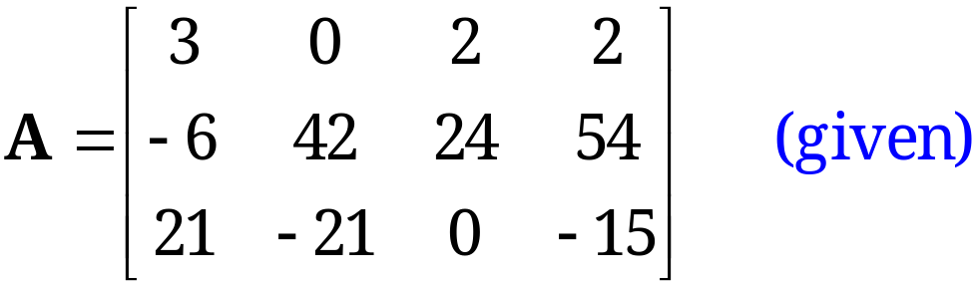
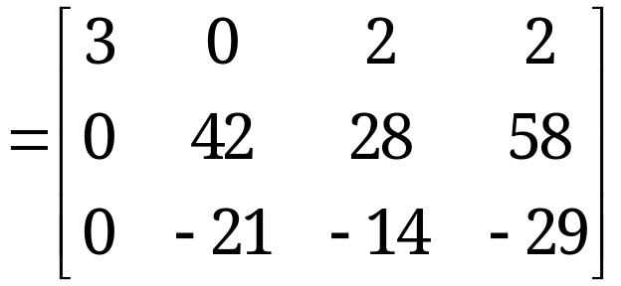
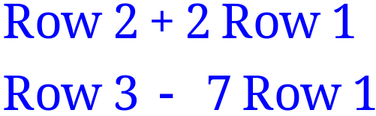
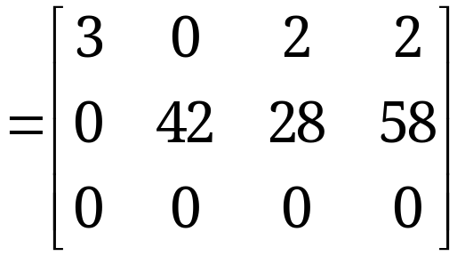
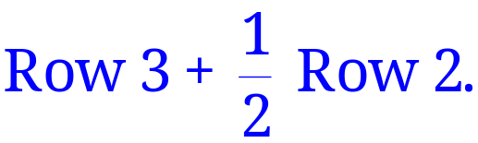
Determination of Rank
The last matrix is in row-echelon form and has two nonzero rows. Hence rank A = 2.

Slide 23
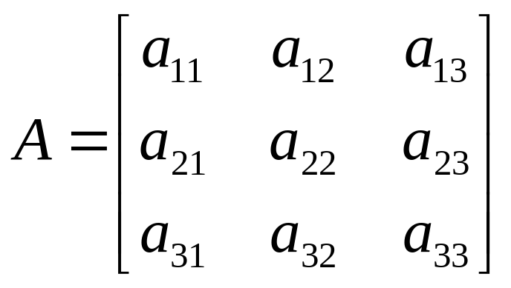
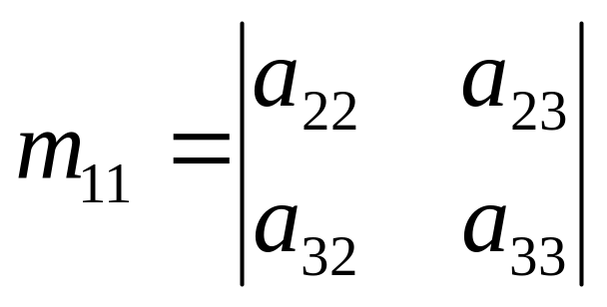
Minor
Each element in A has a minor.
Delete first row and column from A. The determinant of the remaining 2x2 submatrix is the minor of a₁₁ which is a₂₂a₃₃ – a₂₃a₃₂

Slide 24

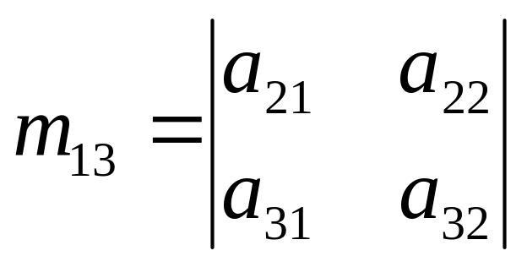
Minor
And the minor for a₁₃ is:

Slide 25
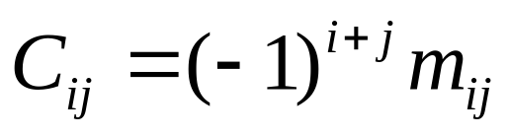
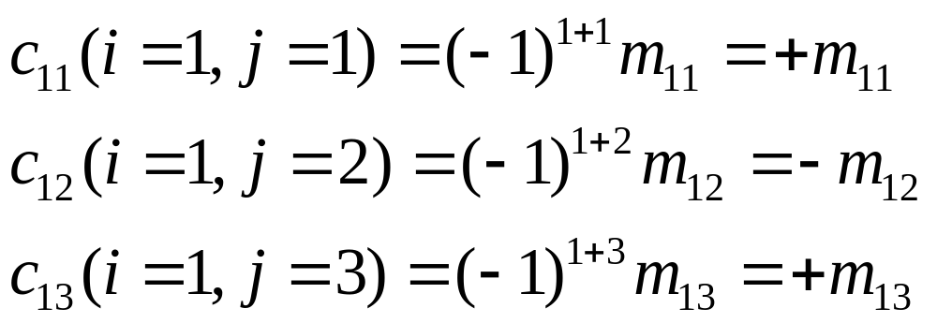
Cofactor
The cofactor C_{ij} of an element a_{ij} is defined as:
When the sum of a row number i and column j is even, c_{ij} = m_{ij} and when i+j is odd, c_{ij} =-m_{ij}

Slide 26
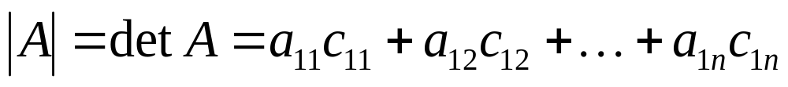
Determinant
The determinant of an n x n matrix A can now be defined as
The determinant of A is therefore the sum of the products of the elements of the first row of A and their corresponding cofactors.
(It is possible to define |A| in terms of any other row or column but for simplicity, the first row only is used)

Slide 27
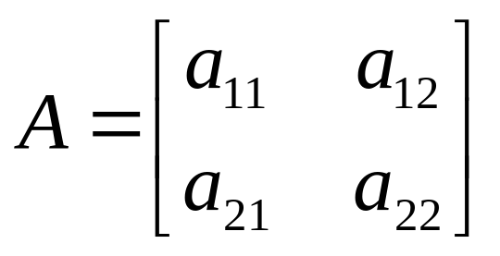
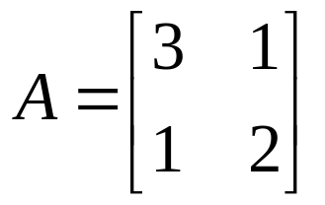
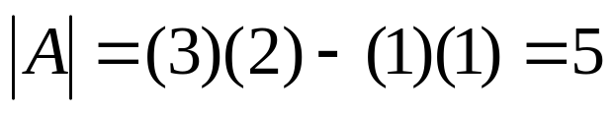
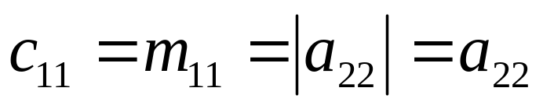
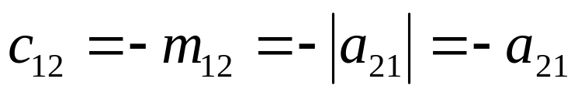
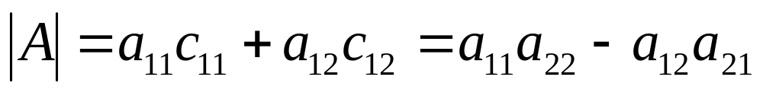
Determinant -Example
Therefore the 2 x 2 matrix :
Example 1:
Has cofactors :
And:
And the determinant of A is:

Slide 28

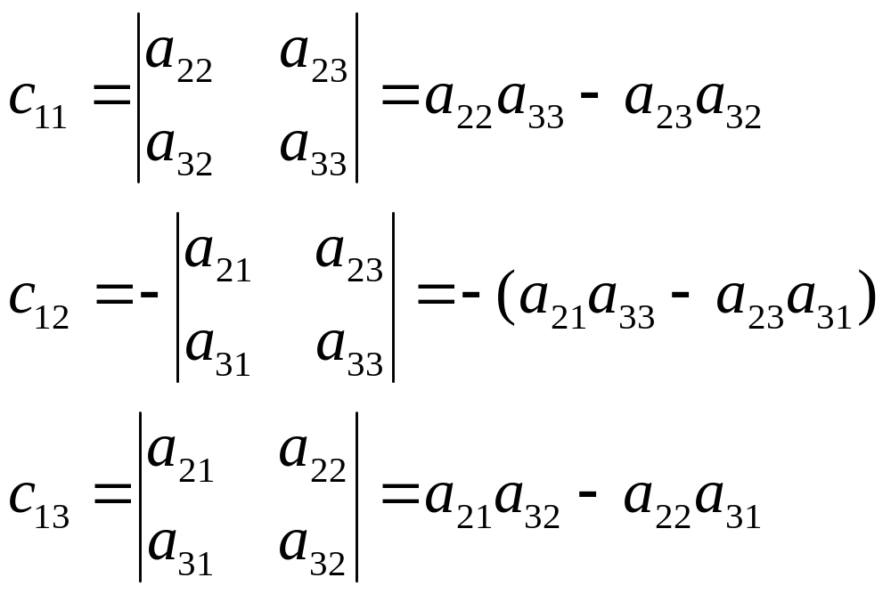
Determinant -Example
The cofactors of the first row are:

Slide 29
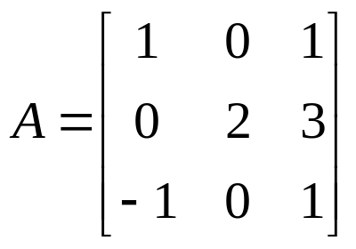
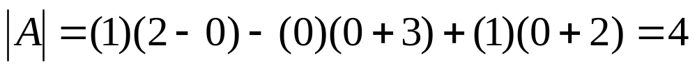
Determinants – Example
Which by substituting for the cofactors in this case is:
Example 2:

Slide 30
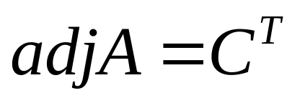
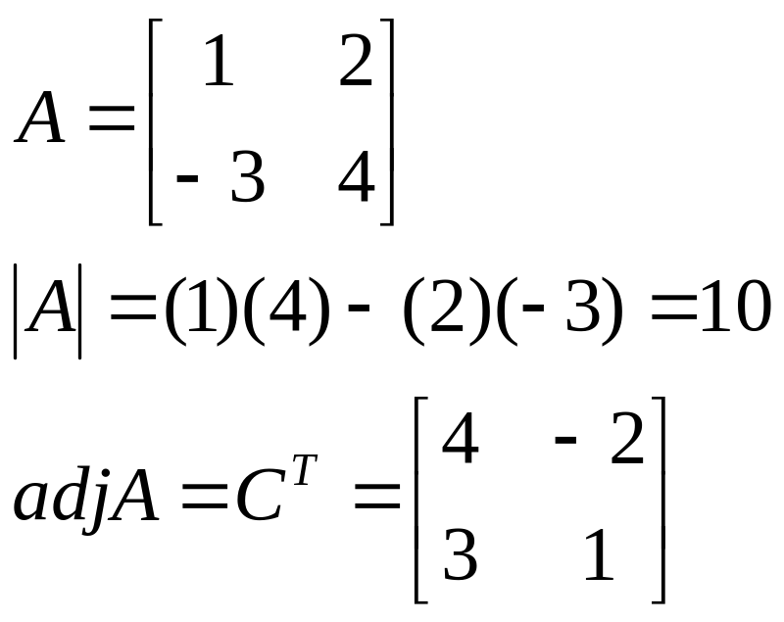
Adjoint
The adjoint matrix of A, denoted by adj A, is the transpose of its cofactor matrix
It can be shown that:
A(adj A) = (adjA) A = |A| I
Example:

Slide 31
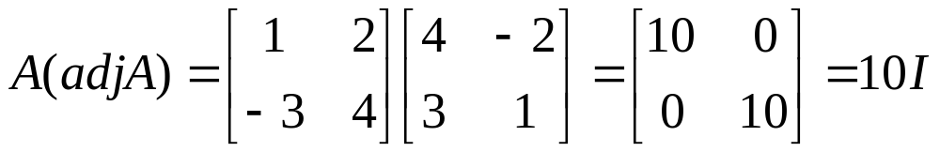
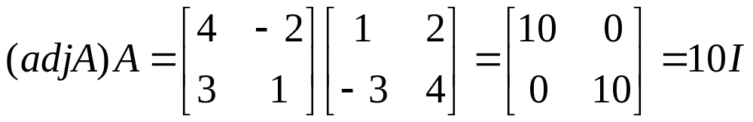
Adjoint

Slide 32
Properties of Determinants
det(AB) =det(A) * det (B)
det(A) nonzero implies there exists a matrix B such that AB=BA=I
Two Rows Equal➔ det = 0(Singular)
R_{i} and R_{j} swapped ➔ det gets a minus sign (i ≠ j)
det(A) = det(A^{T})
R_{i} ← cR_{j} ➔det A ←c detA
Notes:
6.Multiplication of a row by c multiplies the value of determinant by c

Slide 33
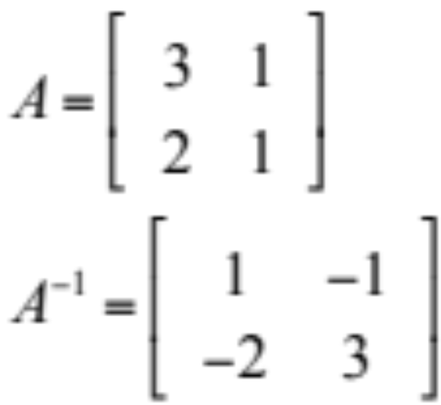
Inverse
A⁻¹ = adj(A) where det(A) ≠ 0
det(A)
Reiterate det(A) ≠ 0 → A is Non singular

Slide 34
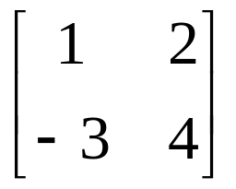
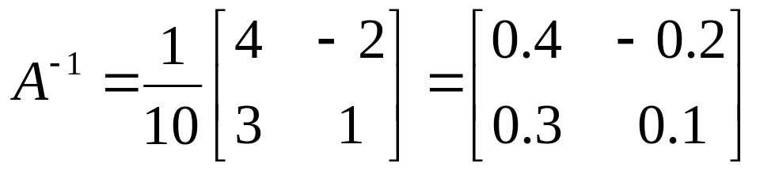
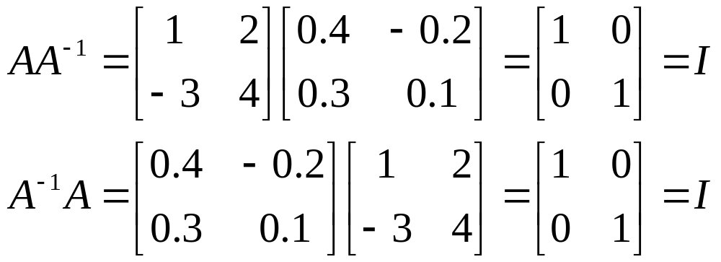
Inverse – 2x2 Example
Example
A =
To check
AA⁻¹ = A⁻¹ A = I

Slide 35
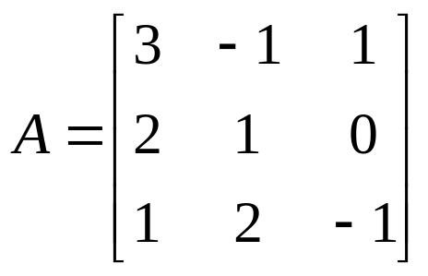
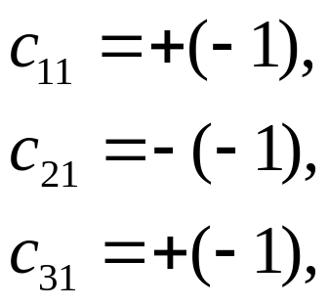


Inverse – 3x3 Example
Example 2
The determinant of A is
|A| = (3)(-1-0)-(-1)(-2-0)+(1)(4-1) = -2
The elements of the cofactor matrix are

Slide 36



Inverse – 3x3 Example
The cofactor matrix is therefore
so
and

Slide 37
Inverse
The result can be checked using
AA⁻¹ = A⁻¹ A = I
The determinant of a matrix must not be zero for the inverse to exist as there will not be a solution
Nonsingular matrices have non-zero determinants
Singular matrices have zero determinants

Slide 38


Inverse -Simple 2 x 2 case
So that for a 2 x 2 matrix the inverse can be constructed in a simple fashion as
Exchange elements of main diagonal
Change sign in elements off main diagonal
Divide resulting matrix by the determinant

Slide 39


Inverse -Simple 2 x 2 case
Example
Check inverse
A⁻¹ A=I

Slide 40

Linear System
A linear system of m equations in n unknowns x₁, … , x_{n} is a set of equations of the form
(1)
The system is called linear because each variable x_{j} appears in the first power only, just as in the equation of a straight line.

Slide 41
Linear System
(1)
a₁₁, … , a_{mn} are given numbers, called the coefficients of the system.
b₁, … , b_{m} on the right are also given numbers.
If all the bj are zero, then (1) is called a homogeneous system.
If at least one bj is not zero, then (1) is called a non-homogeneous system.

Slide 42

Coefficient Matrix
Matrix Form of the Linear System (1).
From the definition of matrix multiplication we see that the m equations of (1) may be written as a single vector equation
Ax = b (2)
where the coefficient matrix A = [a_{jk}] is the m × n matrix
are column vectors.

Slide 43

Augmented Matrix
Matrix Form of the Linear System (1). (continued)
We assume that the coefficients a_{jk} are not all zero, so that A is not a zero matrix. Note that x has n components, whereas b has m components. The matrix
is called the augmented matrix of the system (1).
The dashed vertical line could be omitted, as we shall do later. It is merely a reminder that the last column of Ã did not come from matrix A but came from vector b. Thus, we augmented the matrix A.

Slide 44
Solution to System of Linear Equations
A linear system (1) is called overdetermined if it has more equations than unknowns, determined if m = n, and underdetermined if it has fewer equations than unknowns.
A linear system is consistent if rank(A) = rank(Ã)
A consistent system has at least one solution (thus, one solution or infinitely many solutions), but inconsistent has no solutions at all, as x₁ + x₂ = 1, x₁ + x₂ = 0.

Slide 45
Solution
The method for determining whether Ax = b has solutions and what they are:
(a) No solution. If r is less than m (meaning that R actually has at least one row of all 0s) and at least one of the numbers f_{r+1}, f_{r+2}, … , f_{m} is not zero, then the system Rx = f is inconsistent: No solution is possible. Therefore the system Ax = b is inconsistent as well.

Slide 46
Solution
If the system is consistent (either r = m, or r < m and all the numbers f_{r+1}, f_{r+2}, … , f_{m} are zero), then there are solutions.
(b) Unique solution. If the system is consistent and r = n, there is exactly one solution, which can be found by back substitution.
(c) Infinitely many solutions. To obtain any of these solutions, choose values of x_{r+1}, … , x_{n} arbitrarily. Then solve the rth equation for x_{r} (in terms of those arbitrary values), then the (r − 1)st equation for x_{r−1}, and so on up the line.

